Slide 1
ABIAL Tax Event
LUXEMBOURG TAX POLICY - WHERE DO WE STAND AND WHAT COMES NEXT

Slide 2
1. HYBRID MISMATCH RULES
(ATAD 2)

Slide 3

01
INTRODUCTION
  ATAD 2 provides for comprehensive rules targeting hybrid financing instruments, hybrid entities and permanent establishments that may result in double non-taxation (including long-term tax deferral)
  In general, where a hybrid mismatch results in a “double deduction” (DD) or a “deduction without inclusion” (D/NI), EU Member States should deny a deduction of the payment
  The scope of ATAD 2 encompasses hybrid mismatches between EU Member States and between EU Member States and third states
  The main purpose of the hybrid mismatch rules is the elimination of double non-taxation but tax adjustments should not result in economic double taxation
  The new hybrid mismatch rules apply as from
  1 January 2020

Slide 4

02
IMPACT OF THE HYBRID MISMATCH RULES ON INVESTMENTS
OVERVIEW
  Hybrid mismatches in a fund context may arise in case of:
    Payments under a financial instrument
    Payments made to a hybrid entity
    Payments made by a hybrid entity
    Imported mismatches
  While Article 168ter LITL generally only applies if the hybrid mismatch arises between associated enterprises (threshold, respectively, 25% or 50% in terms of voting rights, capital ownership or profit entitlement), in case of structured arrangements even unrelated parties may come within the scope of the hybrid mismatch rules
  Definition of associated enterprises
  50% (directly or indirectly) link in terms of voting rights, capital ownership or profit entitlement
  Entities that is part of the same consolidated group for financial accounting purposes
  Concept of significant influence on the management
  Reduced threshold of 25% in case of payments under a financial instrument
  Potential aggregation of interests in accordance with the concept of acting together

Slide 5
02
IMPACT OF THE HYBRID MISMATCH RULES ON INVESTMENTS
THE CONCEPT OF ACTING TOGETHER
Investor 1
Investor 2
Investors
3 - 10
  Application of the concept of acting together in a fund context
  Less than 10% de minimis rule
  Broad definition of investment funds for the purposes of the de minimis rule
  Where an investor owns x < 10%, it is assumed that investors are not acting together, unless proven otherwise (burden of proof is on the tax authorities)
  Where an investors owns at least 10%, it has to be analysed on a case-by-case basis (burden or proof is on the taxpayer)
15%
20%
X < 10%
Lux Fund
IBL
CBs
LuxMasterCo
IBL
Lux or local PropCo

Slide 6
02
IMPACT OF THE HYBRID MISMATCH RULES ON INVESTMENTS
RELATED PARTY TEST – CASE STUDIES
ParentCo
100%
100%
Investor 1
(LuxFund regarded as opaque)
Investor 2
(LuxFund regarded as transparent)
Investor 3
(Lux Fund regarded as opaque)
Investors
4 - 10
15%
20%
17.5%
X < 10%
Lux Fund
IBL
CBs
LuxMasterCo

Slide 7
02
IMPACT OF THE HYBRID MISMATCH RULES ON INVESTMENTS
RELATED PARTY TEST – CASE STUDIES
ParentCo
100%
100%
Investor 1
(LuxFund regarded as opaque)
Investor 2
(LuxFund regarded as transparent)
Investor 3
(Lux Fund regarded as opaque)
Investors
4 - 10
25%
27%
12.5%
X < 10%
Lux Fund
IBL
CBs
LuxMasterCo

Slide 8
02
IMPACT OF THE HYBRID MISMATCH RULES ON INVESTMENTS
RELATED PARTY TEST – CASE STUDIES
Investors
4 - 10
X < 10%
Feeder
Fund
Investor 1
(LuxFund regarded as opaque)
Investor 2
(LuxFund regarded as transparent)
31%
9%
60%
Lux Fund
IBL
CBs
LuxMasterCo

Slide 9
02
IMPACT OF THE HYBRID MISMATCH RULES ON INVESTMENTS
RELATED PARTY TEST – CASE STUDIES
Investors
4 - 10
X > 10%
Feeder
Fund
Investor 1
(LuxFund regarded as opaque)
Investor 2
(LuxFund regarded as transparent)
31%
9%
60%
Lux Fund
IBL
CBs
LuxMasterCo

Slide 10
02
IMPACT OF THE HYBRID MISMATCH RULES ON INVESTMENTS
RELATED PARTY TEST – CASE STUDIES
Investors
4 - 10
Investor 1
(LuxFund regarded as opaque)
Investor 2
(LuxFund regarded as transparent)
Feeder Fund
(opaque)
31%
9%
60%
Lux Fund
IBL
CBs
LuxMasterCo

Slide 11
02
IMPACT OF THE HYBRID MISMATCH RULES ON INVESTMENTS
CONSIDERATIONS REGARDING LUXEMBOURG FUNDS
Investor 1
Investor 2
Investors
3 - 10
  Excluding the application of the hybrid mismatch rules:
    Investors are exclusively resident in jurisdictions that classify the Luxembourg fund as transparent?
    Investors are not associated enterprises that own 50% or more in the fund?
    Does the tax status of the investors discharge the application of the hybrid mismatch rules?
  When the hybrid mismatch rules apply, the tax adjustment should not be more than necessary to neutralize the hybrid mismatch outcome
15%
12%
X < 10%
Lux Fund
IBL
CBs
LuxMasterCo
IBL
Lux or local PropCo

Slide 12
02
IMPACT OF THE HYBRID MISMATCH RULES ON INVESTMENTS
CONSIDERATIONS REGARDING FOREIGN FUNDS
Investors
  Foreign fund structures are often driven by US investors
  Given the particularities of US tax law such investment structures may involve different types hybrid mismatch arrangements
  Financing through hybrid financing instruments such as CPECs and PECs
  Hybrid entities in view of check-the-box elections for US tax purposes
  Hybrid mismatches between associated enterprises vs. structured arrangements between unrelated parties
Fund
(abroad)
PECs
CPECs
LuxMasterCo
IBL
Lux or local PropCo

Slide 13
03
LIMITS OF THE HYBRID MISMATCH RULES
  Hybrid mismatch rules shall only apply in regard to payments that are deductible for tax purposes
  Non-deductible payments are not affected
  Mere timing differences shall not trigger non-deductibility
  Downward adjustments that are made to restate arm’s length conditions should not be affected
  When the hybrid mismatch is eliminated by other EU Directives there is no room for the hybrid mismatches to apply
  Inclusion of income at the level of at least one payee is sufficient to discharge the application of the hybrid mismatch rules
  Tax status of the taxpayer (tax exempt taxpayer, resident in a no tax jurisdiction or a jurisdiction with a pure territorial tax regime)
  Dual inclusion income in case of double deductions

Slide 14
04
CHECKLIST
Is there a hybrid mismatch ?
no
yes
Is the related party test satisfied ?
no
yes
Is the hybrid mismatch resulting from a structured arrangement?
no
yes
Would the mismatch outcome have arisen in any case because of the tax status of the investor ?
yes
no
The hybrid mismatch rules apply (tax adjustment as far as necessary to neutralise the mismatch outcome)
The hybrid mismatch rules
do not apply
Are there solutions to manage the impact of the new rules ?

Slide 15
06
HOW TO PREPARE FOR THE NEW RULES?
  A hybrid mismatch analysis will become an integral part of each and every tax advice going forward
  Existing investments need to be reviewed and structure alignments should be implemented
2016
2017
2018
2019
2020
2021

Slide 16

07
CONCLUSION
  The new hybrid mismatch rules apply as from
  1 January 2020
  The new rules are characterized by technical complexity
  Some concepts require further clarifications by the Luxembourg tax authorities
  Management of tax compliance obligations will become more intricate
  Impact on existing and new investments

Slide 17
2. MANDATORY DISCLOSURE REGIME
(DAC 6)

Slide 18
01
Introduction
The 6th EU Directive on Administrative Cooperation (“DAC 6”) aims at the disclosure, by EU intermediaries, of potentially aggressive tax planning arrangements of a cross-border dimension.
The Luxembourg government agreed on a first draft law on 27 July 2019. The wording of the Luxembourg draft law largely resembles the one of DAC 6 and commentaries to the draft law provide only few explanations on how the reporting will be implemented in practice.
Arrangements that come within the scope of at least one of the hallmarks defined in Appendix IV to DAC 6 may need to be reported under the mandatory disclosure regime. However, the reporting obligations are limited to “cross-border” situations, namely those involving either more than one member state or a member state and a third country.
On 14 February 2020, the Luxembourg government published an amended draft law further to formal objections issued by the Luxembourg Council of State. As per the amended draft law, the exemption from reporting obligations applicable to intermediaries subject to professional secrecy has notably been extended to cover auditors and chartered accountants and the requirement for intermediaries subject to professional secrecy to report anonymous information of a general nature has been removed.
If an arrangement is reportable, the intermediary covered by professional secrecy must notify, within 10 days, either (i) the other Luxembourg intermediaries involved, or (ii) in the absence of other intermediaries (or if all intermediaries rely on professional secrecy), the taxpayer, of the fact that an arrangement is reportable. The taxpayer and an intermediary may agree that, notwithstanding this privilege, an intermediary should handle DAC 6 reporting on behalf of the client (a “waiver” of privilege).

Slide 19

02
Design principles and main objectives
  According to the Final Report on BEPS Action 12, mandatory disclosure regimes should satisfy the following design principles:
    such regimes should be clear and easy to understand
    they should balance additional compliance costs to taxpayers with the benefits obtained by the tax administration
  Specifically designed to detect tax planning schemes that exploit the vulnerabilities in the tax systems
  The main purposes of such regimes is to increase transparency by providing tax authorities with early information regarding potentially aggressive or abusive tax planning schemes and to identify the promoters and users of those schemes
  Deterrence is another objective as taxpayers and tax intermediaries may think twice before implementing/ proposing a reportable scheme

Slide 20

03
Key features of the disclosure regime
Reportable arrangements
  Arrangements that come within the scope of one of the hallmarks may have to be reported under the mandatory disclosure regime
  Very broad understanding of the term arrangement (which may also include a series of arrangements)
  The regime is, however, limited to cross-border arrangements (involving more than one Member State or a Member State and a Third State)
  Moreover, many of the hallmarks are subject to a threshold condition (the main benefit test, “MBT”)
  The new regime is relevant for all taxes of any kind levied by, or on behalf of, an EU Member State or the Member State’s territorial or administrative subdivisions, including local authorities
  The regime does not, however, apply to VAT, customs duties or social security contributions
  Luxembourg will implement penalties of up to
  EUR 250,000 for non-compliance

Slide 21
03
Key features of the disclosure regime
Overlapping reporting obligations
  In case more than one tax intermediary is involved, there will be overlapping reporting obligations
  Intermediaries should only be exempt from their reporting obligations to the extent they can proof that the same arrangement has already been filed by another intermediary
  This requires a certain coordination between different advisers in order to avoid multiple filings on the same arrangements
  When the reporting might be made in several EU Member States, the new regime provides for rules to identify one single EU Member State in which the filing should be made
  In case the reporting obligation rests with the taxpayer, there might also be multiple reporting obligations in different EU Member States. Here, the regime provides for rules to identify one single Member State in which the disclosure filings should be made

Slide 22
03
Key features of the disclosure regime
Timing aspects
  Tax intermediaries have to report within 30 days beginning:
    on the day after the reportable cross-border arrangement is made available for implementation, or
    on the day after the reportable cross-border arrangement is ready for implementation, or
    when the first step in the implementation has been made,
    whatever occurs first.

Slide 23
04
THE Hallmarks of reportable arrangements
Hallmarks are generally divided into two categories: generic and specific hallmarks.
  Generic hallmarks target features that are common to promoted schemes, such as the requirement for confidentiality or the payment of a premium fee. Generic hallmarks can be used to capture new and innovative tax planning arrangements as well as mass-marketed transactions that promoters may easily replicate and sell to a variety of taxpayers.
  Specific hallmarks are used to target known vulnerabilities in the tax system and techniques that are commonly used in tax avoidance arrangements such as the use of loss creation, leasing and income conversion schemes (please refer to slide 5 for an overview of the hallmarks).
The reporting regime further limits the number of reportable cross-border arrangements through the adoption of a threshold condition. This means that many of the hallmarks only trigger a reporting obligation to the extent an arrangement meets the main benefit test (“MBT”), reducing the risk of excessive or defensive filings. This should enhance the usefulness of the information collected because the focus will be on arrangements that have a higher probability to serve the purpose of the disclosure regime.
The MBT is fulfilled if “it can be established that the main benefit or one of the main benefits which, having regard to all relevant facts and circumstances, a person may reasonably expect to derive from an arrangement is the obtaining of a tax advantage”. Hence, this test compares the value of the expected tax advantage with any other benefits likely to be obtained from the transaction. According to the Final Report on BEPS Action 12, the MBT sets a relatively high threshold for disclosure.
It is also interesting to note that DAC 6 explicitly states that the tax treatment of a cross-border payment at the level of the recipient thereof cannot alone be a reason for concluding that an arrangement satisfies the MBT.

Slide 24
04
THE Hallmarks of reportable arrangements
Is there an arrangement ?
no
yes
Does the arrangement have a cross-border dimension ?
no
yes
Is one of the hallmarks fulfilled ?
no
yes
no
Is the hallmark subject to the main benefit test (MBT) ?
yes
Is the MBT satisfied ?
yes
no
The arrangement is reportable under the mandatory disclosure regime
The arrangement is not reportable under the mandatory disclosure regime

Slide 25

05
THE MAIN BENEFIT TEST
Questions to be asked in practice
  Is it reasonable to consider that the investment would have been made in the absence of the tax benefit?
  Are the commercial and other benefits more significant than the aggregate amount of tax advantages?
  Are there genuine economic reasons for an investment other than benefiting from a tax advantage?
  Does the arrangement merely rely on the application of tax law (i.e. there exist explicit rules) as opposed to taking advantage of loopholes in the applicable tax systems?
  Is the arrangement known to the tax authorities involved?

Slide 26
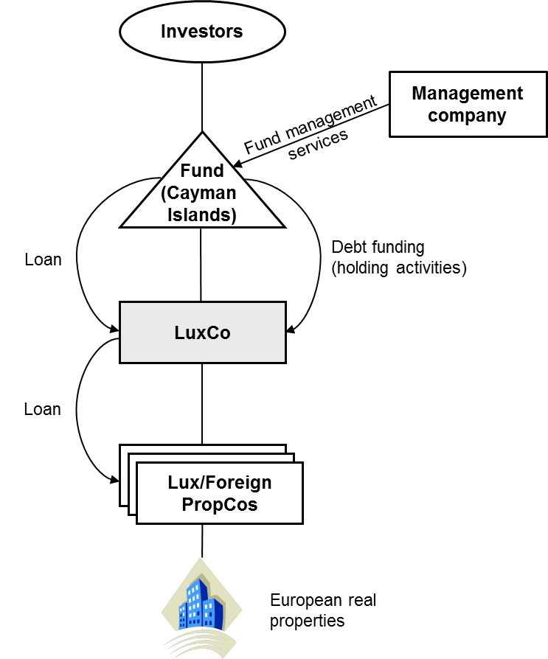

06
CASE STUDIES
  Cross-border arrangement
  The Fund invests into pan-European real estate assets and should as such qualify as cross-border arrangement
  Review of hallmarks
  Generic hallmarks linked to the MBT
    The "Confidentiality" hallmark
    The "Premium fee" hallmark
    The "Standardized tax product" hallmark
  Specific hallmarks linked to the MBT
    The "Loss company" hallmark
    The "Converting income scheme" hallmark
    The "Circular transaction" hallmark

Slide 27

06
CASE STUDIES
Case 1: The foreign fund
  Review of hallmarks
  Specific hallmarks related to cross-border arrangements
    The "No or low taxation" hallmark (deductible cross-border payments)
      Taxation at zero or almost zero
      Full exemption from tax
      Preferential tax regime
  The “No or low taxation” hallmark should be fulfilled given that LuxCo pays interest to the Cayman fund that is exempt from taxation
  On 18 February 2020, the EU Council updated the EU list of non-cooperative tax jurisdictions by adding Cayman Islands, Palau, Panama and Seychelles.
  As far as Cayman Islands is concerned, the Council concluded that "Cayman Islands does not have appropriate measures in place relating to economic substance in the area of collective investment vehicles."

Slide 28
06
CASE STUDIES
Case 1: The foreign fund
  Review of hallmarks
  Specific hallmarks related to cross-border transactions
    The "State-less company" and "black-listed country" hallmark
    The "Double Dip" hallmark
    The "Double relief" hallmark
    The "Step up in value" hallmark
  Specific hallmarks re automatic exchange of information
    The "No CRS Reporting" hallmark

Slide 29
06
CASE STUDIES
Case 1: The foreign fund
  Review of hallmarks
  Specific hallmarks concerning beneficial ownership
    The "Disguising beneficial owners" hallmark
  Specific hallmarks concerning Transfer Pricing
    The "Unilateral safe harbour" hallmark
    The " Hard-to-Value intangibles" hallmark
    The "Business restructuring" hallmark

Slide 30
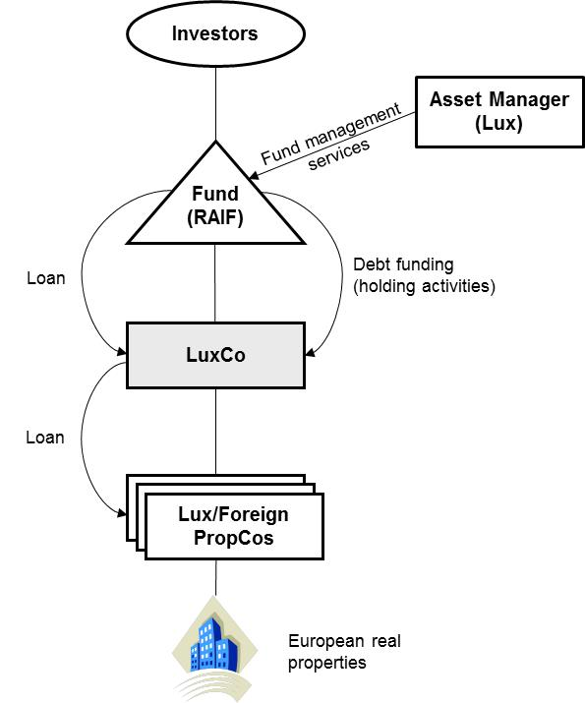
06
CASE STUDIES
  Cross-border arrangement
  The Fund invests into pan-European real estate assets and should as such qualify as cross-border arrangement
  Hallmarks
  The “no or low taxation” hallmark is not fulfilled in the absence of a cross-border element of payments between LuxCo and the Fund
  Perspective of the investment jurisdiction?

Slide 31

07
Managing DAC 6 OBGLIGATIONS in practice
Sanctions for non-filing: taxpayers may be required to report in the absence of an intermediary not covered by professional legal privilege
Contradictory filings between different service providers may trigger questions by tax authorities
Reputational and commercial risks: Certain investors may not want to be seen as investing in potentially aggressive structures and will check whether and how many reports a fund has generated. If investor names are disclosed in reports, reputational issues for investors
Tax risks: Reporting may be considered as a trigger for tax audits
DAC 6 will have a major impact given that employees need to be aware, appropriately trained and internal procedures have to be reviewed, adopted and implemented in order to
  identify critical transactions;
  find potential structuring alternatives (where appropriate);
  avoid reputational damage;
  comply with legal reporting obligations; and
  mitigate the risk of penalites.

Slide 32
07
Managing DAC 6 OBGLIGATIONS in practice
How should taxpayers prepare for the MDR?
  How to manage the obligations under DAC 6 in practice:
    Develope and implement a DAC 6 policy that defines the process followed, who is in charge, etc. Ensure that it is covered in the investment committee
    Track potentially reportable cross-border arrangements and the tax intermediaries involved to be sure to meet the 30-day legal deadline.
    Analyse whether cross-border transactions should be reportable under DAC 6 or not (i.e. as part of a tax memo, a separate tax memo or a tax opinion)
    Contractual elements in engagement letters with service providers that ensure the involvement of the taxpayer, i.e. no reporting without preliminary information of the taxpayer
    Monitor the implementation of DAC 6 in other jurisdictions (e.g. the investment jurisdictions)

Slide 33
07
Managing DAC 6 OBGLIGATIONS in practice
Taking a Look at the Tax Intermediaries
Involvement in potentially reportable cross-border arrangements
Stakeholders in the MDR reporting in Luxembourg
Potential tax intermediaries
Taxpayer
Tax Adviser
Lawyer
Accountant/ Domiciliation
Bank
Auditor

Slide 34
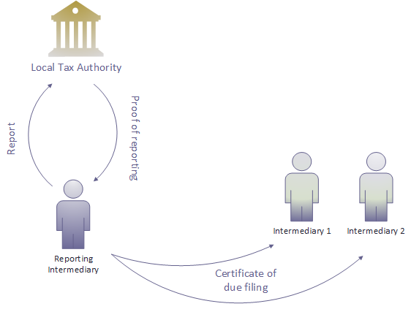
07
Managing DAC 6 OBGLIGATIONS in practice
Connecting intermediaries and taxpayers
Consider the use of a collaborative tool that facilitates the connection of all relevant stakeholders involved in a given transaction.
That collaborative feature is the answer to two important elements emerging from DAC 6:
  Ensure appropriate reporting without any risk of overreporting
  If more than one intermediary is involved, only one filing of the same arrangement is required
A good coordination and communication amongst taxpayers and intermediaries are the key to manage DAC6 obligations successfully without facing overlapping reporting and over-disclosure

Slide 35
07
Managing DAC 6 OBGLIGATIONS in practice
Connecting intermediaries and taxpayers
The use of a collaborative tool may also help to keep control over which intermediary is reporting the arrangement:
  If the assessment is positive and the intermediary is not protected by professional legal privilege, the intermediary may apply to the role of reporting intermediary.
  Where there are more than one applicant, the beneficiary of the transaction is responsible for electing the most appropriate intermediary to submit the report to its tax authority.
Is the arrangement reportable under the MDR?
yes
Is the intermediary protected by the professional secrecy?
no
Does the intermediary apply to the role of RI?
yes
Is the intermediary elected to the role of RI
by the beneficiary ?
yes
The reporting is performed by the RI

Slide 36
3. VAT UPDATE
VAT GROUP AND VAT DEDUCTION RIGHT OF HOLDING COMPANIES

Slide 37
01
VAT group
Substantive conditions (cumulative)
Financial link: A direct or indirect link of control resulting from relationships shall be characterized (e.g. a certain % of participation in the capital).
Economic link: A certain level of cooperation shall exist between group members (forms of cooperation listed in the VAT Law).
Organizational link: Such a link implies several items stated in the VAT Law (e.g. joint management).
Formal requirements
Declaration of incorporation of a VAT group to be submitted in due time to the VAT Authorities
The financial link has to be certified by a statutory auditor or a chartered accountant i) upon the submission of a declaration of incorporation of a VAT group and ii) annually.

Slide 38
02
VAT deduction right of holding companies
Holding companies without VAT deduction right
Holding companies with a (partial) VAT deduction right
Costs directly linked to interest bearing loans and management services: VAT should be deductible
2. Costs directly linked to shareholding: VAT should not be deductible (final cost)
3. Other costs: VAT deduction right / methodology to be determined in light of the overall activities and the nature of the services received

Slide 39
4. LUXEMBOURG TAX REFORM
WHERE DO WE STAND ON THE MEASURES ANNOUNCED IN THE COALITION AGREEMENT?

Slide 40

01
KEY MEASURES
Individuals: Individual taxation
Concept: One single tax class (abolition of the different tax classes), taking however into account children
Announced objectives:
  Neutrality: A neutral taxation model which does not depend on the life style and the family status (marriage, partnership, divorce, etc.) ;
  Fairness: abolishment of unjustified advantages, with appropriate compensatory measures and transitional phases;
  Decrease of the tax burden of the individuals (is it really feasible for those who are currently in class 2?).

Slide 41

01
Key measures
Individuals: other tax measures
Stock-options: gradual abolition;
Employees’ participation: implementation of a legal basis for the participation of employees in the profits of their companies with the objective of enhanced employee loyalty;
Carried interest: analysis of the current regime in order to determine whether improvements are required (notably by expanding the scope in order to attract more “front office” functions) ;
Impatriates: replace the circular by a law;
Benefits in kind: introduction of lump sum exempt amounts and modernisation of the lunch voucher regime,

Slide 42

01
Key measures
Individuals: other tax measures
Ecological taxation:
  Further encourage the use of cars with zero or low emissions through introduction of appropriate tax measures;
  Home working: negotiations with Belgium, France and Germany to find an appropriate tax treatment, which will ameliorate home home working opportunities for frontier workers.
Innovative companies: tax measures to increase investments made by individuals in innovative companies.
Accommodation: increase the tax credit for an amount of EUR 20,000 on stamp duties.

Slide 43

01
Key measures
Companies: tax measures for funds
No increase of the subscription tax.
Tax measures for sustainable and socially responsible investment funds
Measures to counteract abuse resulting from the use of the applicable tax system for SICAV-SIFs in the Luxembourg real estate sector

Slide 44

01
Key measures
Real Estate
Property Tax Reform;
Increase of the tax credit regarding the stamp duty for first property acquisitions (« Bëllegen Akt ») according to the number of children in the household ;
Possible increase of the maximum amount for which the super-reduced VAT rate of 3% is applicable in case of accommodation.

Slide 45

02
Current state of play
Individuals
Individual taxation
Stock-options
Employees’ participation
Carried interest
Impatriates
Benefits in kind
Ecological tax
Home working
Innovative firms

Slide 46

02
Current state of play
Legal entities
Adaptation of the tax system | Decrease of the tax rate in 2019. What else?
Sustainable investment funds | Proposition CSV law (subscription tax of 0.01%)
Subscription tax rate
Simplification of CIT/MBT rules
SICAV-SIFs and real estate sector

Slide 47
2
Current state of play
Real Estate sector
Reform of the property tax
VAT super-reduced rate regarding accommodation
Tax on the creation of the added value
Accommodation (tax credit) | Proposition CSV law (increase from 20,000 to 50,000 EUR).

Slide 48
5. OUTLOOK
WHAT COMES NEXT?

